Slide 1
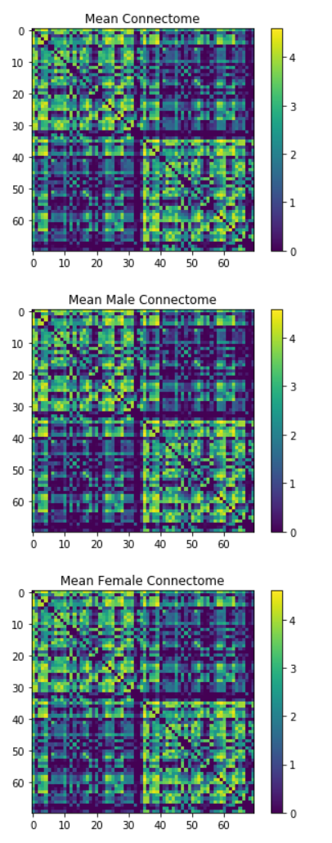
GRAPH ANALYSIS
Daniel Qian, Nathan Vallapureddy, Jenny Wu - Intro to Connectomics
CONNECTOME CREATION
Compute log matrix (mean of all men/women), use plt.imshow

Slide 2
CLASSIFICATION FEATURES
nx.closeness_centrality: higher values of node closeness indicate a higher centrality
nx.betweenness_centrality: shortest elements that pass through a node
Number of edges
Log of the sum of every row
nx.average_clustering: computes the average clustering of nodes
Mean of each value in the matrix

Slide 3
TROUBLESHOOTING/RESULTS
Misalignment of data
Random Forest
Naive Bayes

